Slide 3

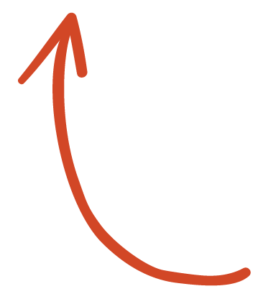
Here's your outline to get started
Key facts
An estimated 1 million people worldwide die by suicide every year. It is estimated that global annual suicide fatalities could rise to over 1.5 million by 2020. Globally, suicide ranks among the three leading causes of death among those aged 15–44 years. Attempted suicides are up to 20 times more frequent than completed ones.
Per recent WHO releases, social stigma, the taboo to openly discuss suicide, and low availability of data lead to poor data quality for both suicide and suicide attempts: "given the sensitivity of suicide – and the illegality of suicidal behaviour in some countries – it is likely that under-reporting and misclassification are greater problems for suicide than for most other causes of death.
It is important to remember however that at a global level, suicide has declined by 29% since 2000.
See more: Open the Notes below for more information.

Slide 4

Related topics to research
Do happy people commit suicide
Suicide by age groups
Gender differences in suicide
Happiness score vs suicide
Suicide in western countries
Suicide in Norway
Suicide in Denmark
Suicide in Iceland
Suicide in Switzerland
Suicide in Finland
Suicide in Netherlands
Suicide in Canada
Suicide in New Zealand
Suicide in Sweden
Suicide in Australia
Use Smart Lookup to learn more
1
Highlight one of the related topics
Right-click on the topic
Choose "Smart Lookup"
2
3

Slide 5
Suicide rates among the top ten happiest countries
What does it all mean?

Slide 6
Contents
International trends in suicide among the top ten countries 2000-2016 data
Total suicide by age
Total suicide by gender
Total suicide by country

Slide 7
Trends in suicide among the ten happiest countries
At a global level, suicide has declined by 29% since 2000.
There is a correlation among the age groups
More males commit suicide than females*
Happiness has no correlation to suicide

Slide 8
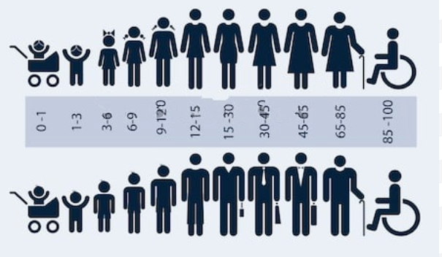
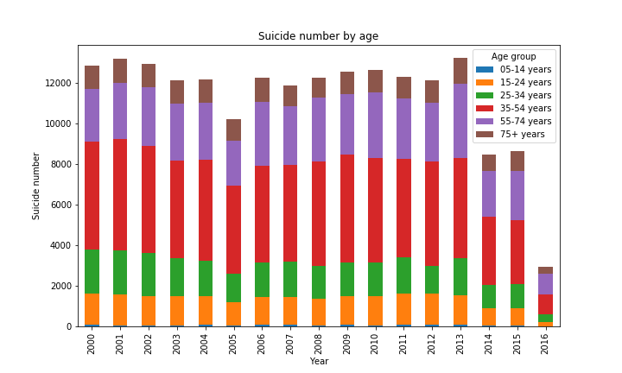
Suicide - does age matter?

Slide 9
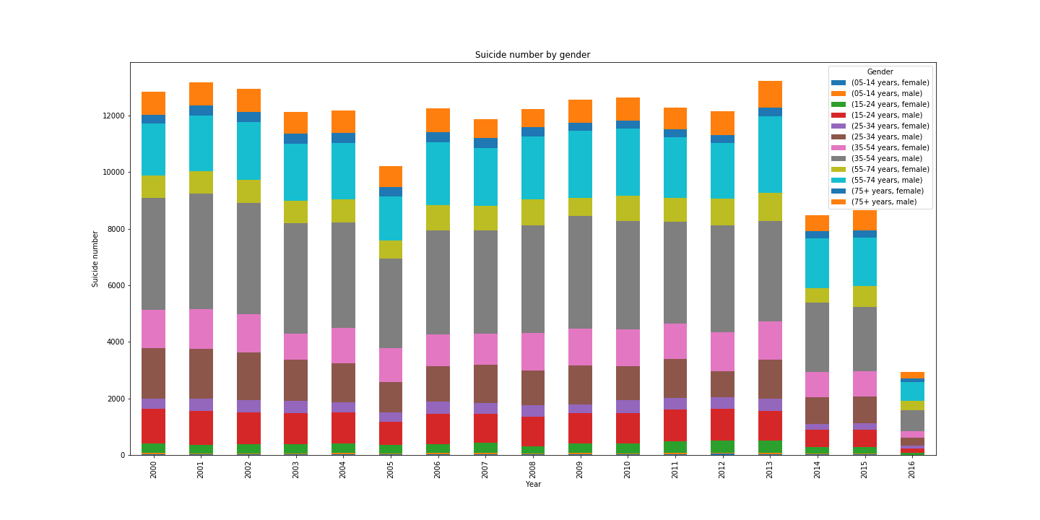

Gender vs the numbers

Slide 10
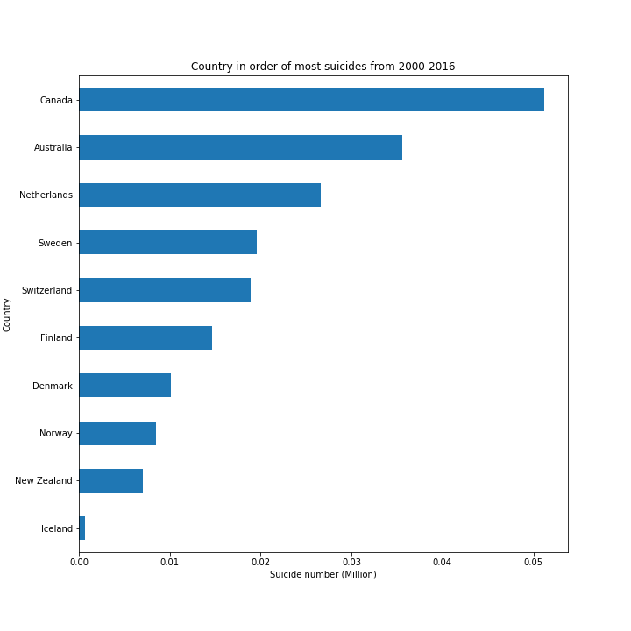
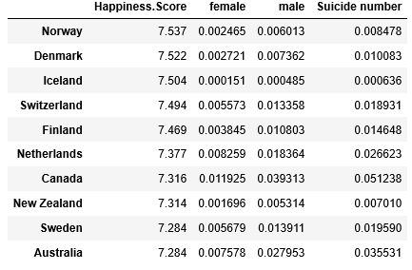
Top ten happiest vs the numbers

Slide 11

Notes:
Consider talking about:
By state
College students
Military
LGBTQ
Chronic pain
Autism

Slide 12
Works cited
World Happiness dataset: https://www.kaggle.com/unsdsn/world-happiness
Suicide dataset: https://www.kaggle.com/russellyates88/suicide-rates-overview-1985-to-2016
Rates are falling: https://www.economist.com/the-economist-explains/2018/11/30/why-the-global-suicide-rate-is-falling
Suicide Prevention Hotline: https://suicidepreventionlifeline.org/

Slide 13
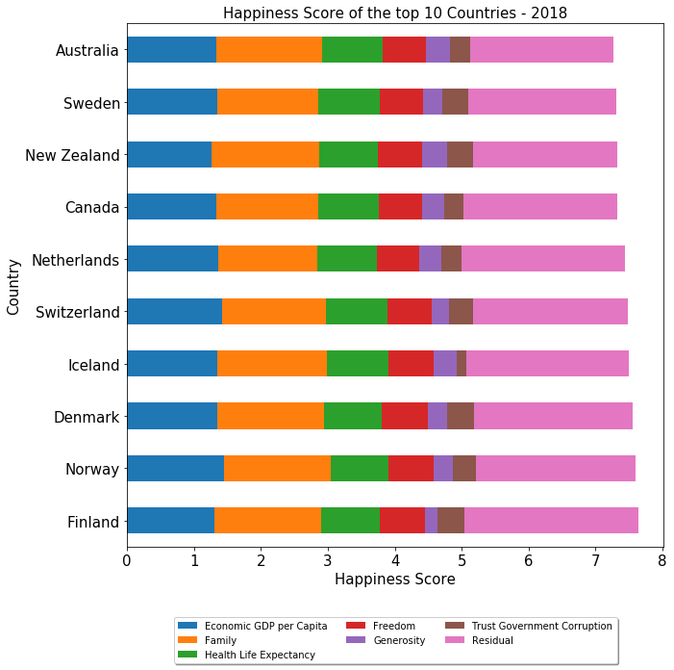
World Happiness Report Data Analysis (2015 - 2018)
Purpose of this project is to find happiest countries in the world and analyze world happiness report to understand the factors contributing to happiness score.
This project also tries to relate happiness score of countries with external elements to identify and understand possible trends.
According to 2018 happiness report, Finland is ranked as happiest country with a happiness score of 7.632 and United States is ranked as 18th.
In 2018, 7 countries in top ten are from Western Europe, 2 of them are Australia and New Zealand and 1 country (Canada) from North America.
‘Economic GDP per Capita’ and ‘Family’ are major contributors toward happiness score.
External factors ‘World Unemployment Rate’ and ‘Economic Freedom Data’ is analyzed to explore the relationship between happiness score and these factors.

Slide 14
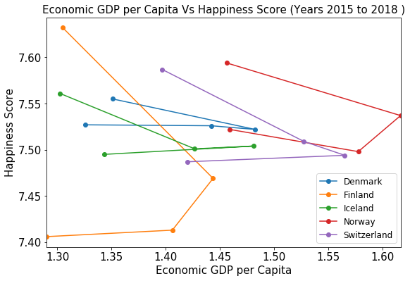
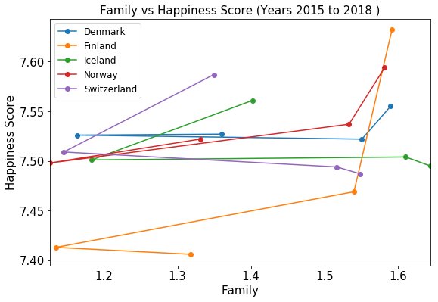
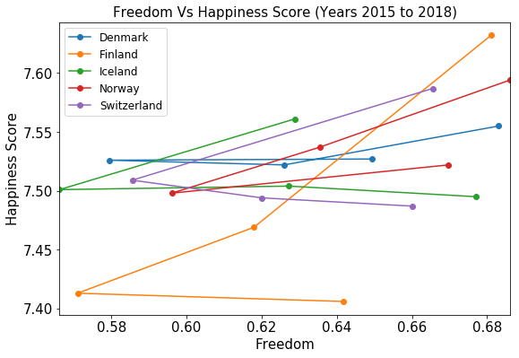
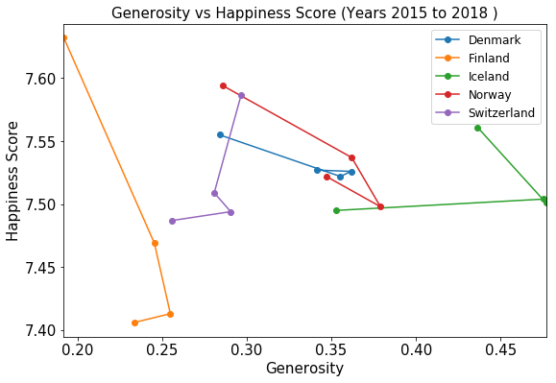
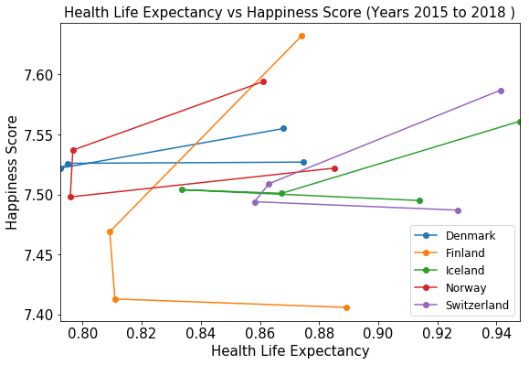
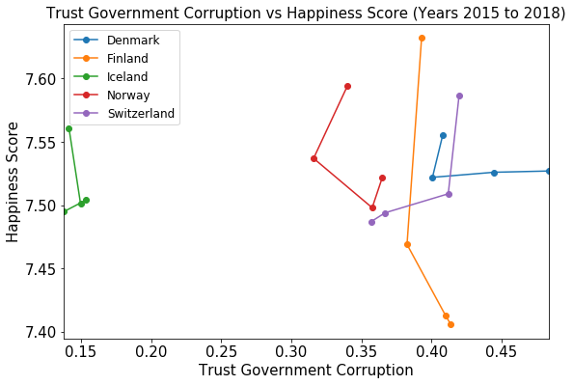
Analyzing Individual Factors Contributing to Happiness Score (2015 - 2018)
Analyzing individual factors of top 5 countries
Family, Freedom and Health Life Expectancy contributes positively towards happiness score.
Economic GDP per Capita is a major contributor but it is not a strong deciding factor for happiness score in case of top 5 countries.
Generosity and ‘Trust Government Corruptions’ does not provide any conclusive trends towards happiness score .

Slide 15
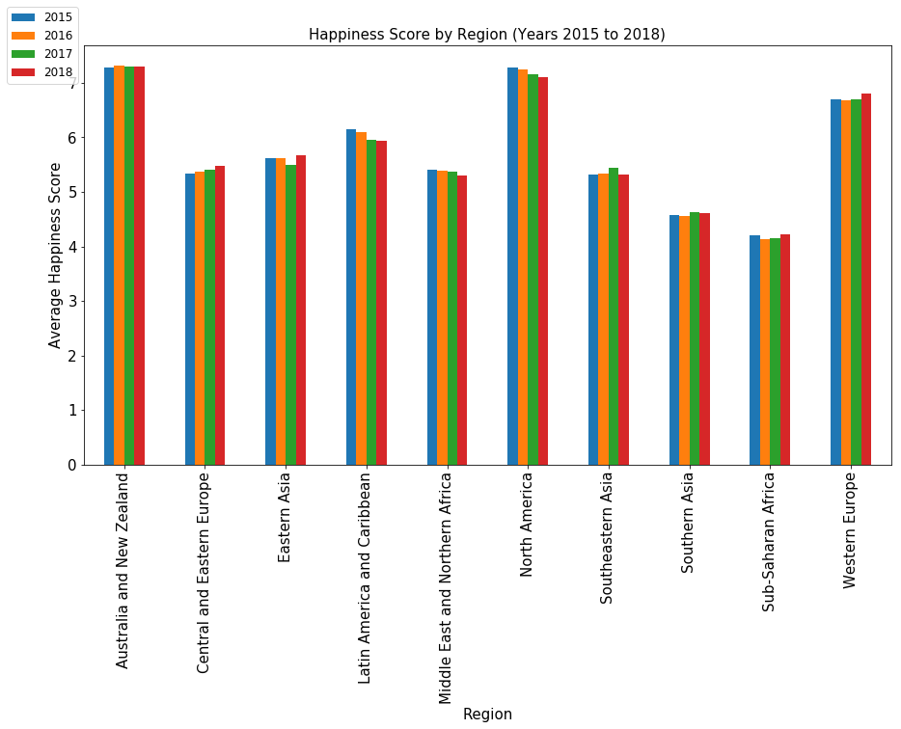
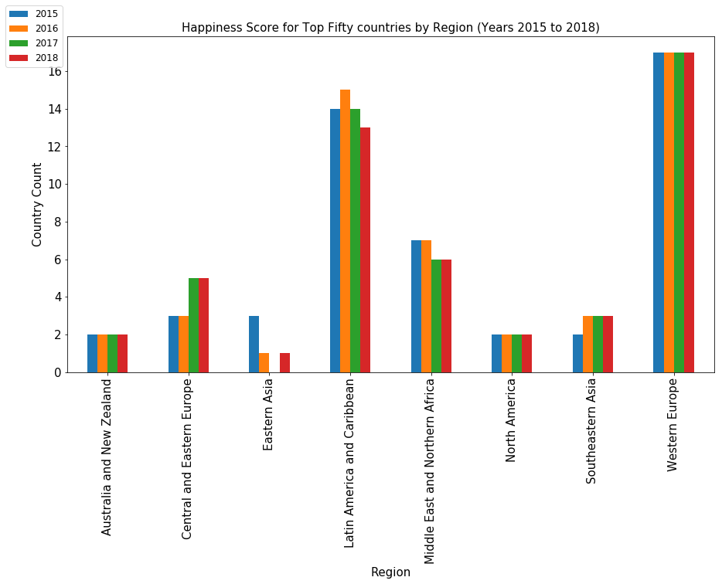
Analyzing Happiness Score By Region (2015- 2018)
Australia and New Zealand, North America and Western Europe are the happiest regions.
Sub-Saharan Africa and Southern Asia are the least happy regions.
Happiness score in Central and Eastern Europe increase over the years while North America, Latin America and Caribbean see a decrease
Australia and NZ [2 out of 2] and North America [2 out of 2] are constantly in top 50 in last 4 years.
Western European countries represent most number [17 out of 21], followed by Latin America and Caribbean countries.
None of the countries from Southern Asia and Sub-Saharan Africa made into top 50 in last 4 years.

Slide 16
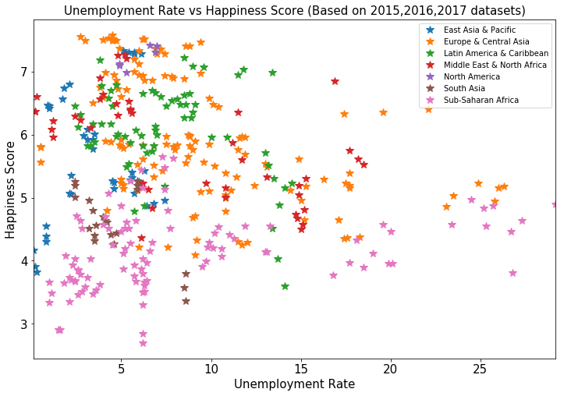
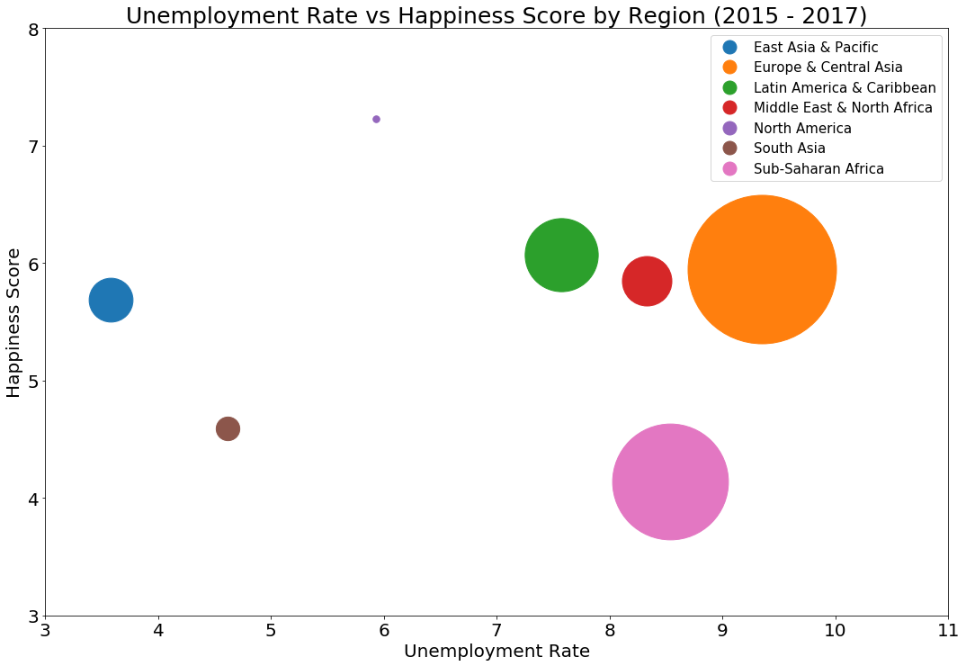
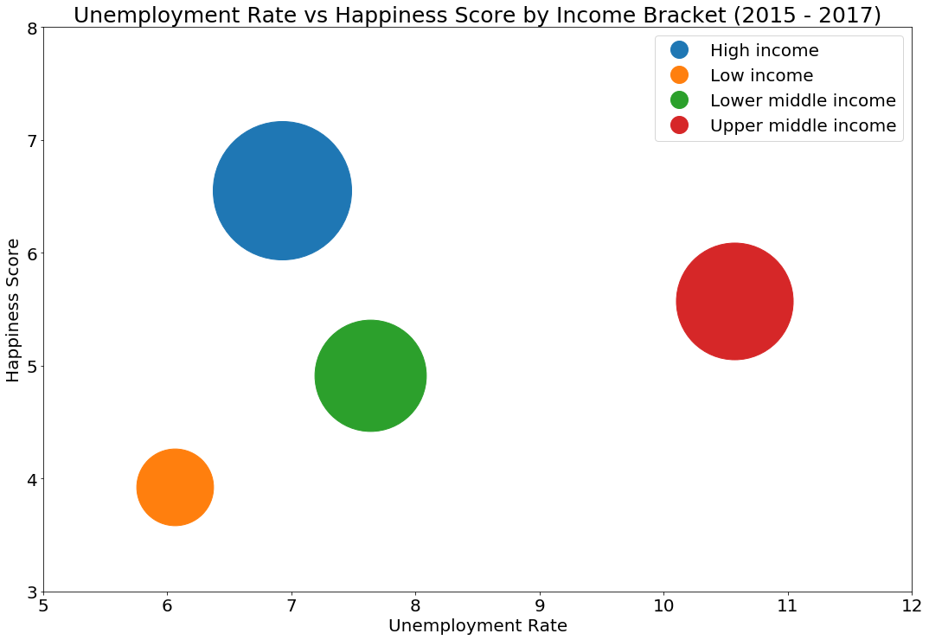
Analyzing Happiness Score Based on Unemployment Rate (2015 - 2017)
Happiness score is inversely proportional to unemployment rate.
North American countries have highest happeniness score with considerably lower unemployment rate.
East Asia & Pacific have better happiness score and lowest unemployment rate.
Sub-Saharan African is the least happy region and unemployment rate is comparatively high.
Countries in high income bracket have highest happiness scores.
Low income countries have lower happiness score regardless of low unemployment rate

Slide 17
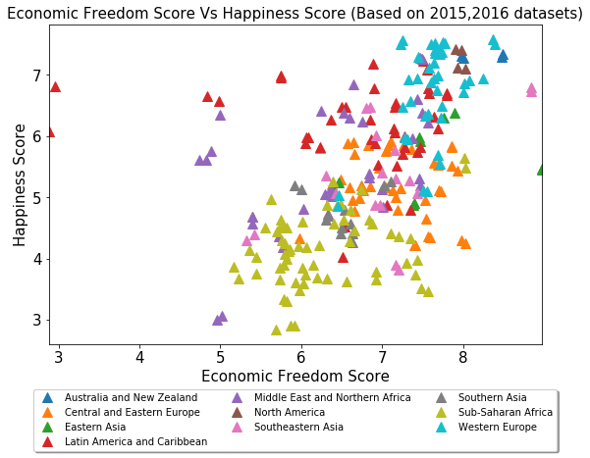
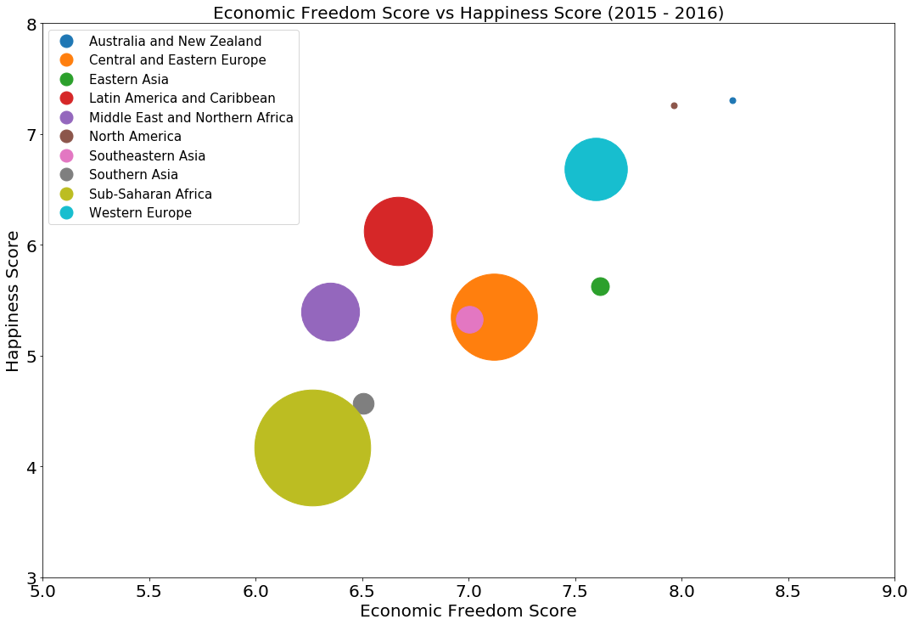
Analyzing Happiness Score Based on Economic Freedom(2015 -2016)
The economic freedom is an important factor contributing to the happiness score of a country.
North America, Australia and New Zealand are happiest regions with best economic freedom.
Western European region have highest happiness score and have comparatively good economic freedom.
Sub-Saharan Africa is the least happiest region with lowest economic freedom.

Slide 18
CONCLUSION
Family, Economic GDP per Capita, Health Life Expectancy, Social Freedom, Economic Freedom, Generosity, Corruption are some of the major factors influencing the world happiness score.
Countries which have lower unemployment rate and high income have higher happiness score.
Economic Freedom increases the world happiness rate.
Happiest countries are in the Western Europe.
Australia and New Zealand, North America and Western Europe are the happiest regions.
Sub-Saharan Africa and Southern Asia are the least happy regions.
As per the latest report Finland is the happiest country in the world.
Considering last 4 years happiness report, top five countries are always from Western Europe

Slide 19
Review of the OECD Data
17 of the top 20 happiest countries (based on the World Happiness Report 2019) ranked in the top 20 for the World Happiness Report for past 5 years.
Finland has ranked in the top 6 over the past 5 years.
The United States has dropped from 15th to 19th over the past 5 years.
Interestingly, several of the happiest countries are OECD members.
We reviewed OECD data to see what insights we could uncover on Leisure Time, Volunteer Time , and Personal Time.
In particular, we took a look at Finland compared US.
Rank (World Happiness Report 2019) | Country | OECD Country | I# of times in the top 20 Happiness Index past 5 years
1 | Finland | Yes | 5
2 | Denmark | Yes | 5
3 | Norway | Yes | 5
4 | Iceland | Yes | 5
5 | Netherlands | Yes | 5
6 | Switzerland | Yes | 5
7 | Sweden | Yes | 5
8 | New Zealand | Yes | 5
9 | Canada | Yes | 5
10 | Austria | Yes | 5
11 | Australia | Yes | 5
12 | Costa Rica | No | 5
13 | Israel | Yes | 5
14 | Luxemburg | Yes | 5
15 | United Kingdom | Yes | 3
16 | Ireland | Yes | 5
17 | Germany | Yes | 4
18 | Belgium | Yes | 5
19 | United States | Yes | 5
20 | Czech Republic | Yes | 1

Slide 20
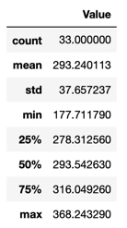
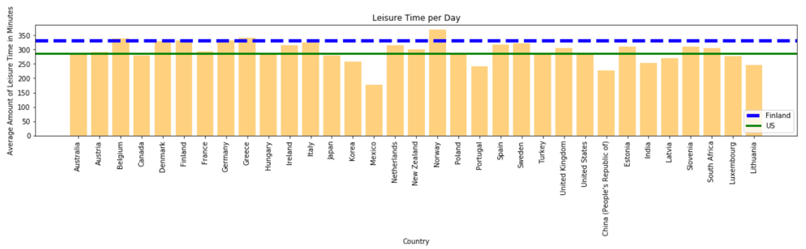
Leisure Time
Upper Quartile
#1: Norway is the highest ranked at ~368 mins
#2: Greece ~341 and #3 Germany ~331
#4 : Finland ~330 and #5 Denmark ~328
US in the Lower Quartile at ~ 286 min
OECD Definition: Leisure Time spent socializing; attending cultural, entertainment and sports events; in hobbies, games and other pastime activities; participating in sports and outdoor activities; using mass media; performing other leisure activities. (Note: Data spans different years for different countries).
Source: OECD Database

Slide 21
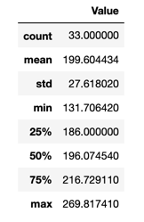
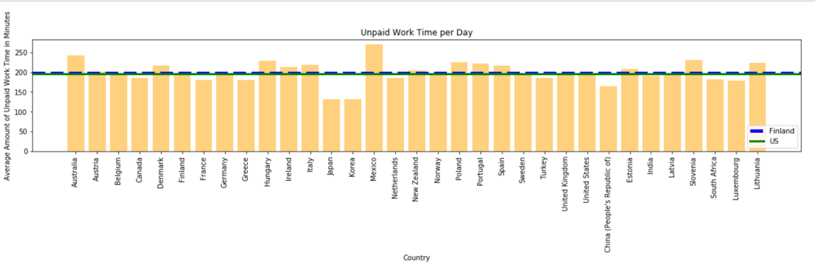
Volunteering (used Unpaid Work Time)
Insights
OECD Definitions includes much more than volunteering in Unpaid Work Time
Finland and US are close at ~196
Mexico highest at ~269
Korea lowest at ~131
OECD Definition: Time spent in unpaid work includes: routine housework; shopping; care for household members; child care; adult care; care for non-household members; volunteering; travel related to household activities; other unpaid activities. (Note: Data spans different years for different countries).

Slide 22
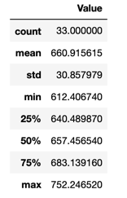
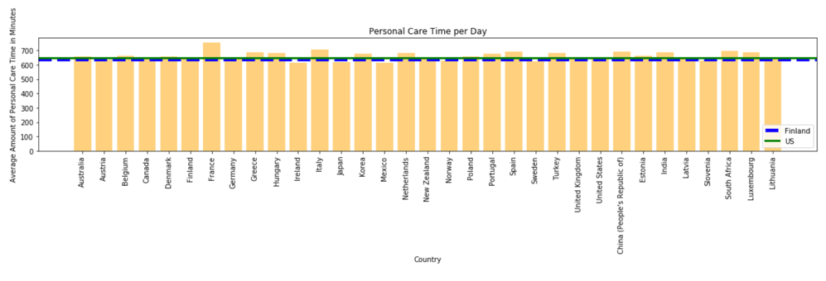
Personal Care Time
Insights
Interestingly, there is less variation in scoring among all participants, making this measure relatively meaningless in comparing happiness.
Finland ~ 640 min and US ~648 min
OECD Data Definition: Time spent in personal care includes: activities required by the individual in relation to biological needs (sleeping, eating, resting etc.); performing own personal or household health-care and maintenance or receiving this type of care; travel for personal care activities in relation to spiritual care; doing nothing, resting, relaxing, meditating, thinking, & planning. (Note: Data spans different years for different countries).

Slide 23
OECD Data-SEt Conclusions
Data commonalities that tie to higher overall Happiness Rankings
More Leisure time is connected
Volunteering - need more detailed / specific data to refine this
Personal Care – appears to be about inline with all OECD countries

Slide 24
Group Projects Conclusion
Data commonalities that tie to higher overall Happiness Rankings
Developed Infrastructure
Higher Economic Freedom
Lower Rates of Un-employment
More Leisure time

